Slide 1
Food Distribution Program
Getting Started in WBSCM
Part I: Browser Set Up
Texas Department of Agriculture
USDA Division

Slide 2
Acknowledgement Statement
You understand and acknowledge that:
The training you are about to take does not cover the entire scope of the program; and that
You are responsible for knowing and understanding all handbooks, manuals, alerts, notices, and guidance, as well as any other forms of communication that provide further guidance, clarification, or instruction on operating the program.

Slide 3
RA User Check-In
Scan the QR Code to access
the 2-question check-in
or copy the link below and paste into your browser.
https://bit.ly/3Xm4wLq
Notes:
Image: https://www.harding.edu/academics/colleges-departments/education/graduate-programs/mental-health-wellness-programs/assets/images/slider_clinical_mental_health.jpg

Slide 4
01
Course Introduction
Course Outline and Objectives

Slide 5
Introduction
01
Course Objectives and Outcomes.
Getting Started
02
Bookmarking, pop-ups, and other settings.
03
Training Environment Log-In and Portal Components
Logging in to WBSCM training environment view.
WBSCM Getting Started Course Outline

Slide 6
Course Objectives and Outcomes
By the end of this course, participants will be able to:
Update browser privacy settings for optimal WBSCM use
Log into WBSCM Training Environment
Identify WBSCM portal components and where to find content and system updates
Identify WBSCM specific terminology

Slide 7
02
WBSCM Getting Started
Bookmarking, Pop-Ups and Other Settings
Notes:
Before accessing
Certain setting in Google Chrome must be enabled in order to access and use all function in WeBSCM

Slide 8
WBSCM Browser Set Up
WBSCM Recommended Browser: Google Chrome
Update Browser and Security Settings in Chrome for WBSCM Optimal Use.
Bookmark Portal Site Address
Enable Pop-Ups
Enable PDF Downloads
Notes:
TRAINER NOTE-IMPORTANT
If any of the following security settings are not allowable for an RA per their district IT permissions, have RAs perform the following steps:
Notify their IT Administrator
Share the following link with their IT Administrator: https://www.usda.gov/topics/food-and-nutrition/web-based-supply-chain-management
Share the Browser Settings and Helpful Tips Job Aid PDF (File has been uploaded into SharePoint RA101 Material Folder) with their IT Administrator

Slide 9
Updating Latest Version of Chrome

Slide 10
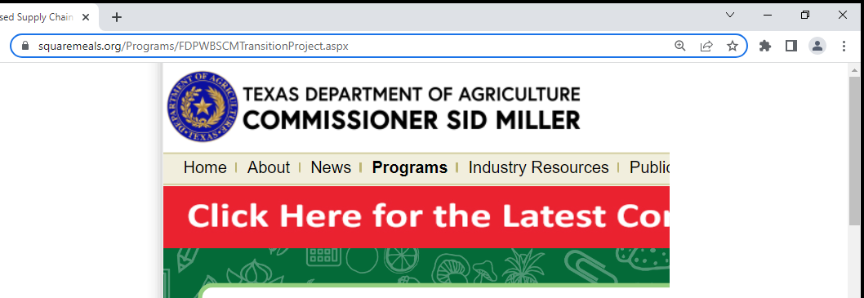
Updating Google Chrome Browser
Click on vertical dots located at upper-right hand of browser
Notes:
Updating Google Chrome periodically will assist in optimal use of WBSCM.
To update browser, follow the steps and directions on each slide.
Once you have opened Google Chrome in order to update to the latest version
You will see 3 vertical dots at the top right hand side of your browser
Some systems might tell you it needs an update some will not
We’ll go through the process to make sure you have the latest version
So click on the 3 dots and you will get a command box pop up
Go down and click on “Help” – another command box
Click About Google Chrome to update the browser

Slide 11
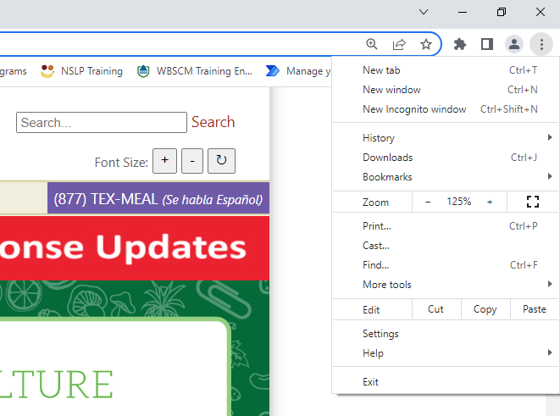
Updating Google Chrome Browser
Drop down box will appear

Slide 12
Updating Google Chrome Browser
Click on "Help"

Slide 13
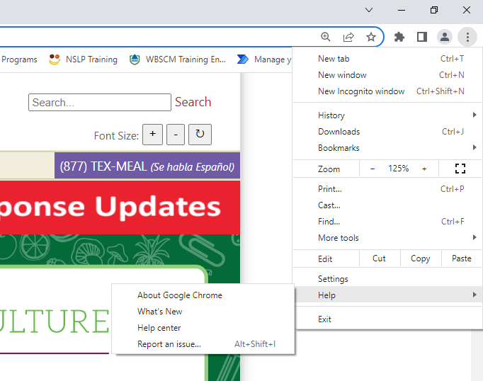
Updating Google Chrome Browser
Click "About Google Chrome" when new drop box appears

Slide 14
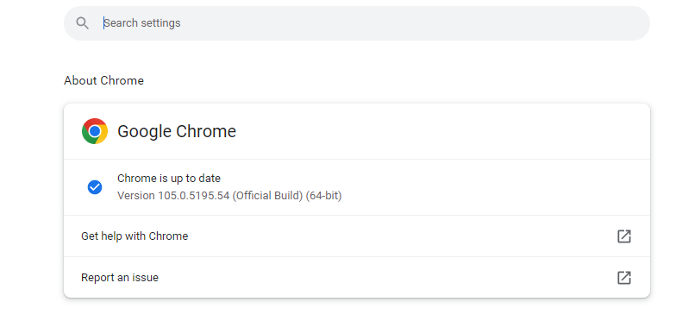
Updating Google Chrome Browser
"Chrome is up to date" will appear if no updates necessary
Notes:
TRAINER NOTE-IMPORTANT NOTE:
Latest versions of Chrome will change over time.
This screenshot will not show the most up to date version number of Chrome, this number will change with every update.

Slide 15
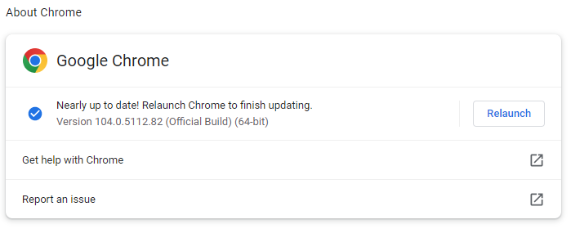
Updating Google Chrome Browser
Chrome will automatically load updates
When update is complete, a "relaunch" button will appear

Slide 16
Updating Google Chrome Browser
Click "Relaunch" to complete updates

Slide 17
WBSCM Training Portal Bookmarking (Logging in Not Necessary to Bookmark)

Slide 18
WBSCM Training Environment (NTRN) URL
wbscmntrn.wbscm.usda.gov
Notes:
You do not have to login
Type web address into browser for bookmarking WBSCM Training Environment
wbscmntrn.wbscm.usda.gov
Users WILL NOT LOG IN during this module. Bookmarking website does not require log in.

Slide 19
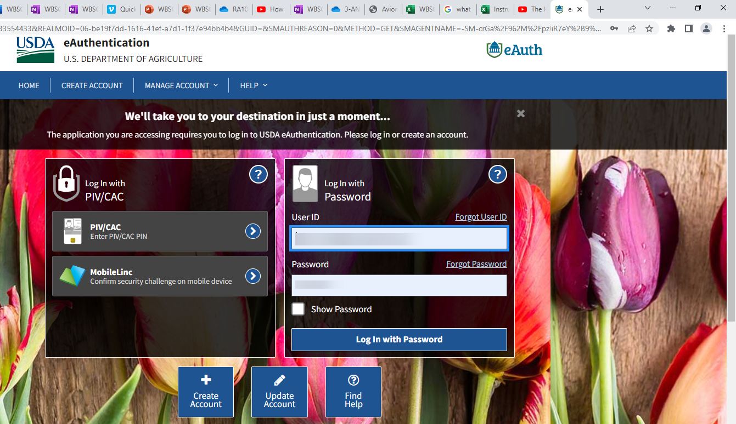
WBSCM Training Portal Bookmarking
Click on Star in address bar to book-mark.
Notes:
Follow directions on slides to bookmark WBSCM training environment.

Slide 20
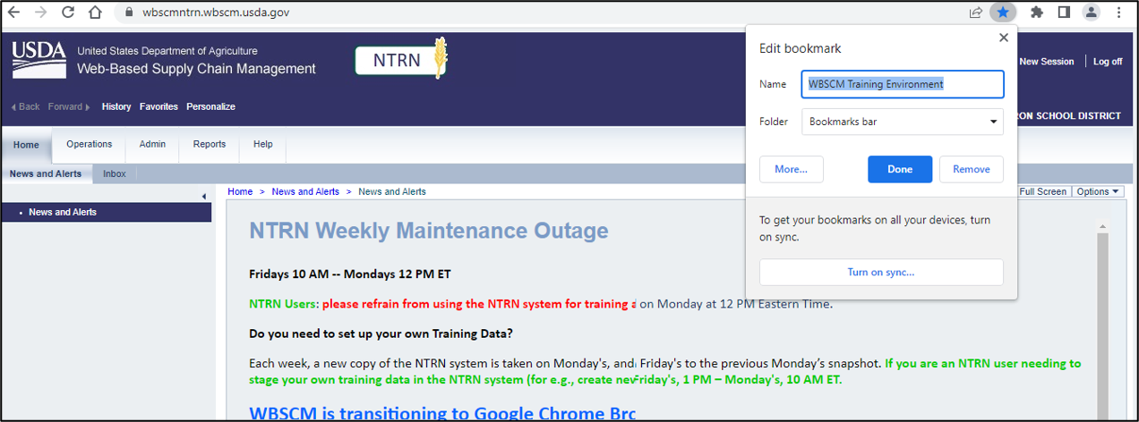
WBSCM Training Portal Bookmarking
Type: "WBSCM Training Environment" in the Name box to label the bookmark.
Click the done button to finish adding bookmark
Notes:
Name the bookmark: Type "WBSCM Training Environment" into the Name field.

Slide 21
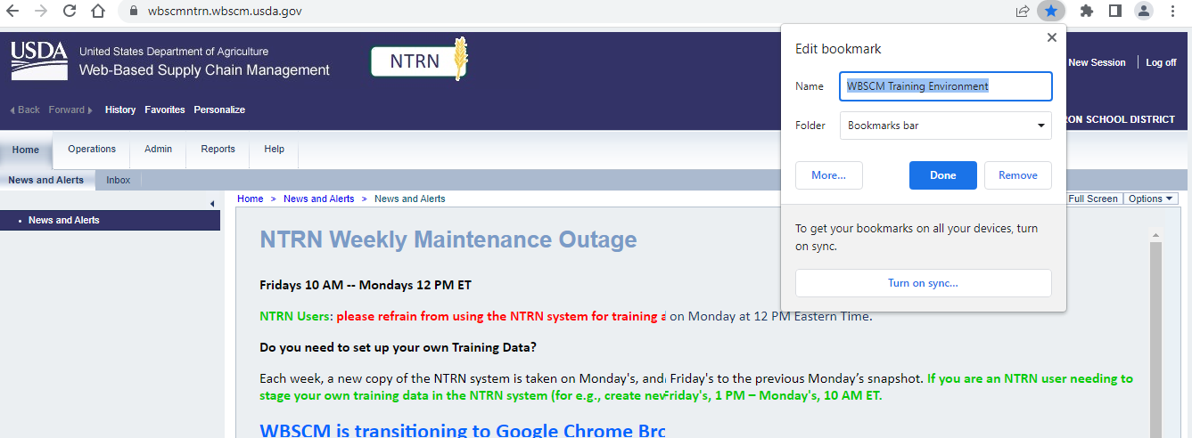
Bookmarking Site in Chrome
Blue Star Indicates Bookmarked Site.

Slide 22
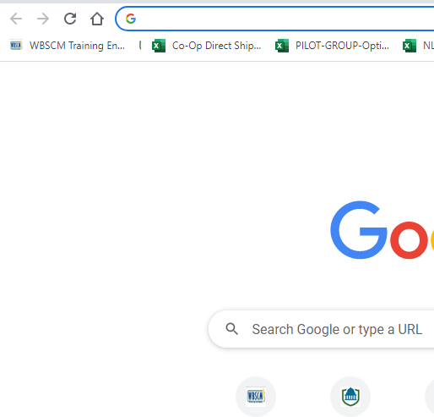
WBSCM Training Portal Bookmarking
Portal icon may be found under the search bar.
Notes:
Users can drag bookmark icon to be placed in a prominent position under the web address bar.

Slide 23
Disabling Pop-Blocker in Chrome
Notes:
TRAINER NOTE-IMPORTANT
Enabling Pop-Ups is a function that is necessary to make WBSCM work properly. This function is vital to successfully submit requests in WBSCM

Slide 24
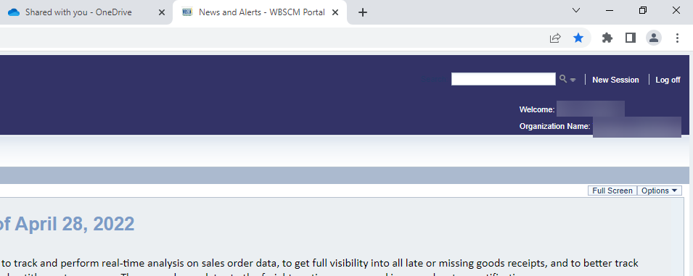
Disabling Pop-Blocker in Chrome
Web Address Bar
Click on the three dots on the upper right-hand corner of your browser
Notes:
Follow the directions on the slides to enable pop-ups/disable pop up blocker.

Slide 25
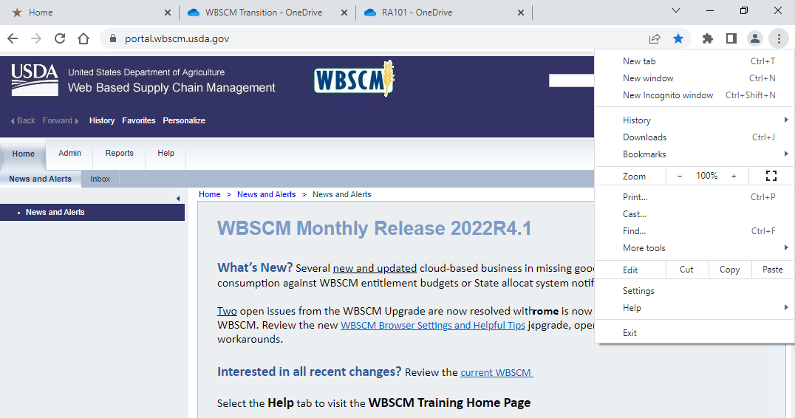
Disabling Pop-Blocker
Web Address Bar
Click on settings

Slide 26
Disabling Pop-Blocker
Click on privacy and security

Slide 27
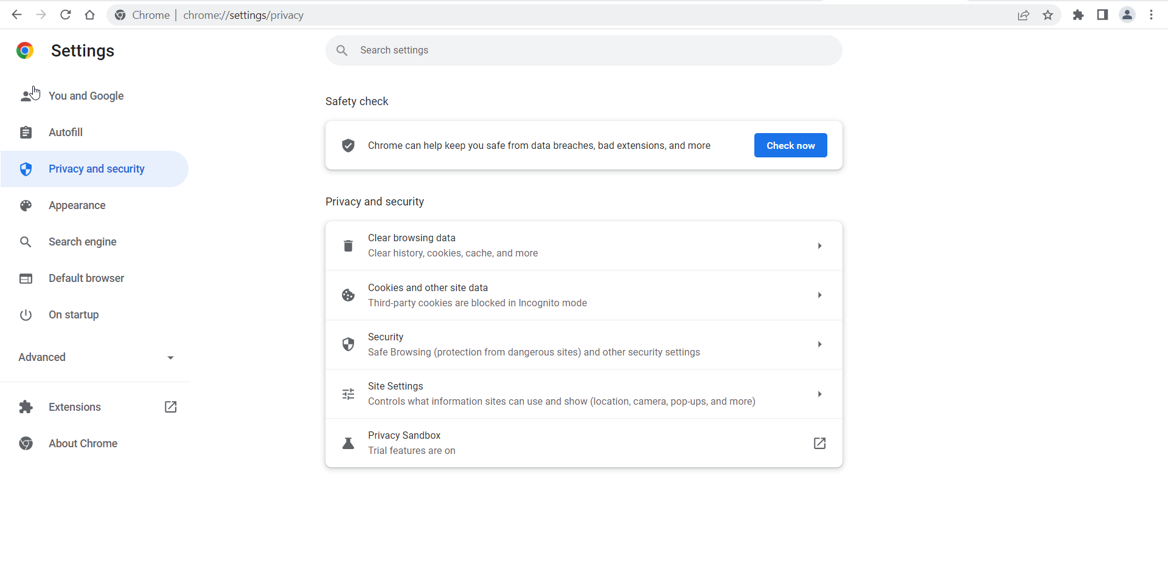
Disabling Pop-Blocker
Click on Site Settings

Slide 28
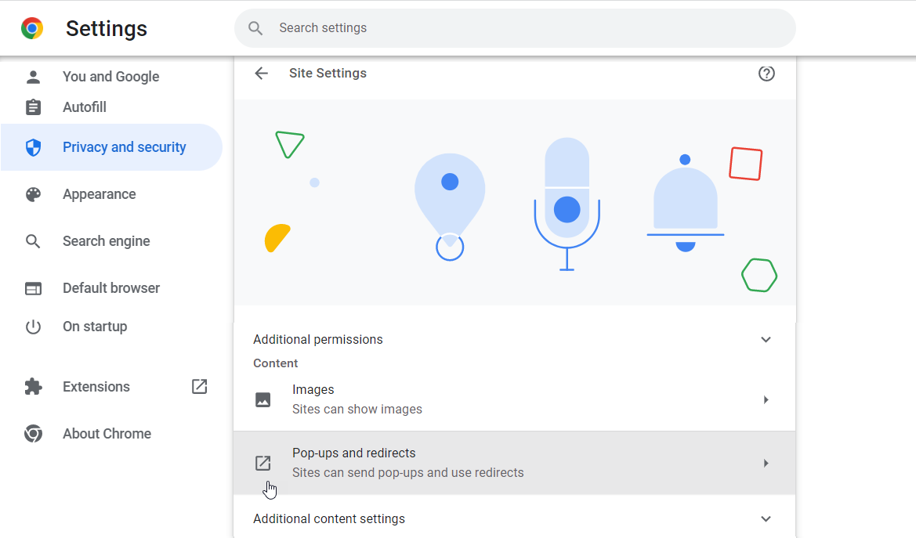
Disabling Pop-Blocker
Scroll down and click on Pop-Ups and redirects

Slide 29
Disabling Pop-Blocker
Option #1: Allow pop-ups for all websites.

Slide 30
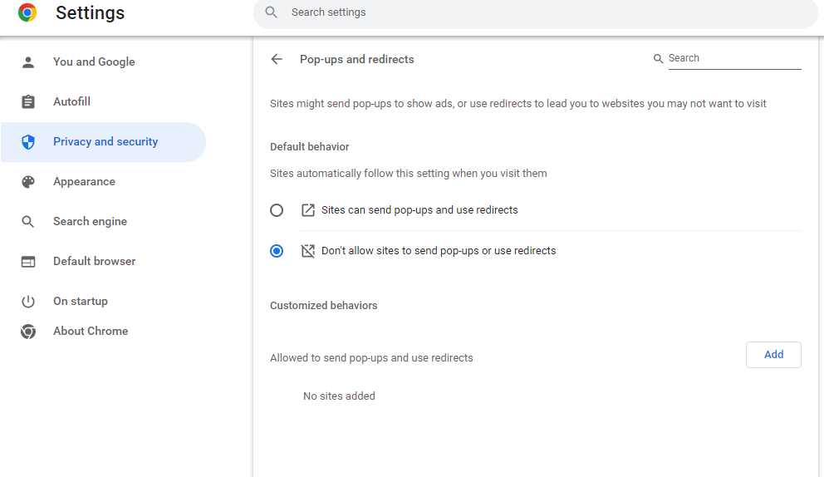
Disabling Pop-Blocker
Option #2: Click "Don't allow sites to send pop-ups or use redirects"
Notes:
TDA encourages users choosing Option 2 to promote more control over site redirects and pop-ups

Slide 31
Disabling Pop-Blocker
Option #2: Click Add button for "Allowed to send pop-ups and redirects"
Notes:
Scroll down to the bottom of Google Chrome browser/screen to Allowed to Send Pop-Ups and Use Redirects

Slide 32
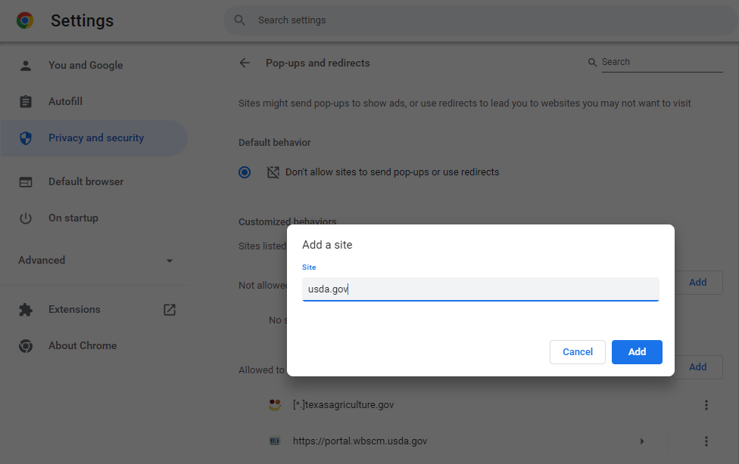
Disabling Pop-Blocker
Type in usda.gov and click add
Notes:
Any site ending with a usda.gov domain name will be allowed under allowable pop-ups.

Slide 33
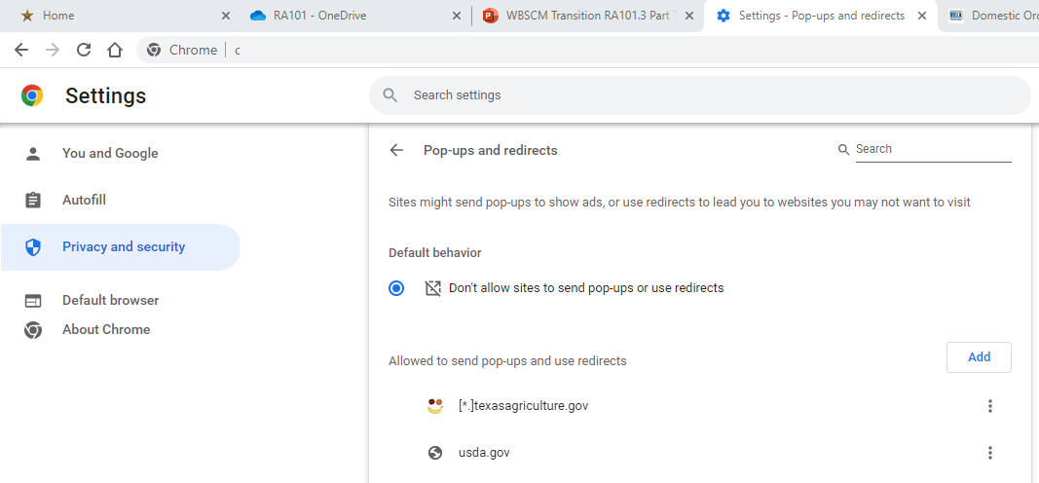
Disabling Pop-Blocker
Web address listed under allowable pop-ups

Slide 34
Enable PDF Downloads in Chrome
Notes:
Follow the directions on the slides to enable PDF Download settings. Some users may not be able to enable PDFs due to district security settings. See note on Browser Set Up Summary Page (Found on Slide 8 as of 08/04/23)
This setting does not prohibit users from successfully using WBSCM

Slide 35
Enable PDF Download Settings
Web Address Bar
Click on the three dots on the upper right-hand corner of your browser

Slide 36
Enabling PDF Download Settings
Web Address Bar
Click on settings

Slide 37
Enable PDF File Download Settings
Click on privacy and security

Slide 38
Enable PDF File Download Settings
Click on "Site Settings"

Slide 39
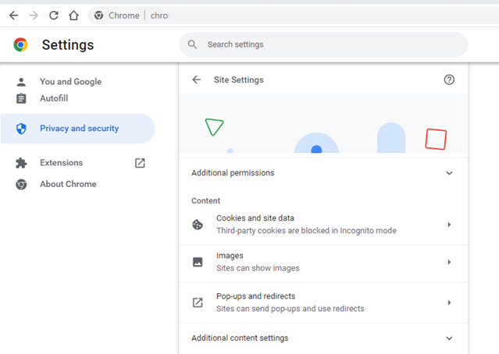
Enable PDF File Download Settings
Click on "Additional Content Settings" Arrow
Notes:
Scroll all the way down browser to find Additional content settings

Slide 40
Enable PDF File Download Settings
Click on "PDF documents" arrow

Slide 41
Enable PDF File Download Settings
Click "Download PDFs" and close browser tab.

Slide 42
Questions?

Slide 43
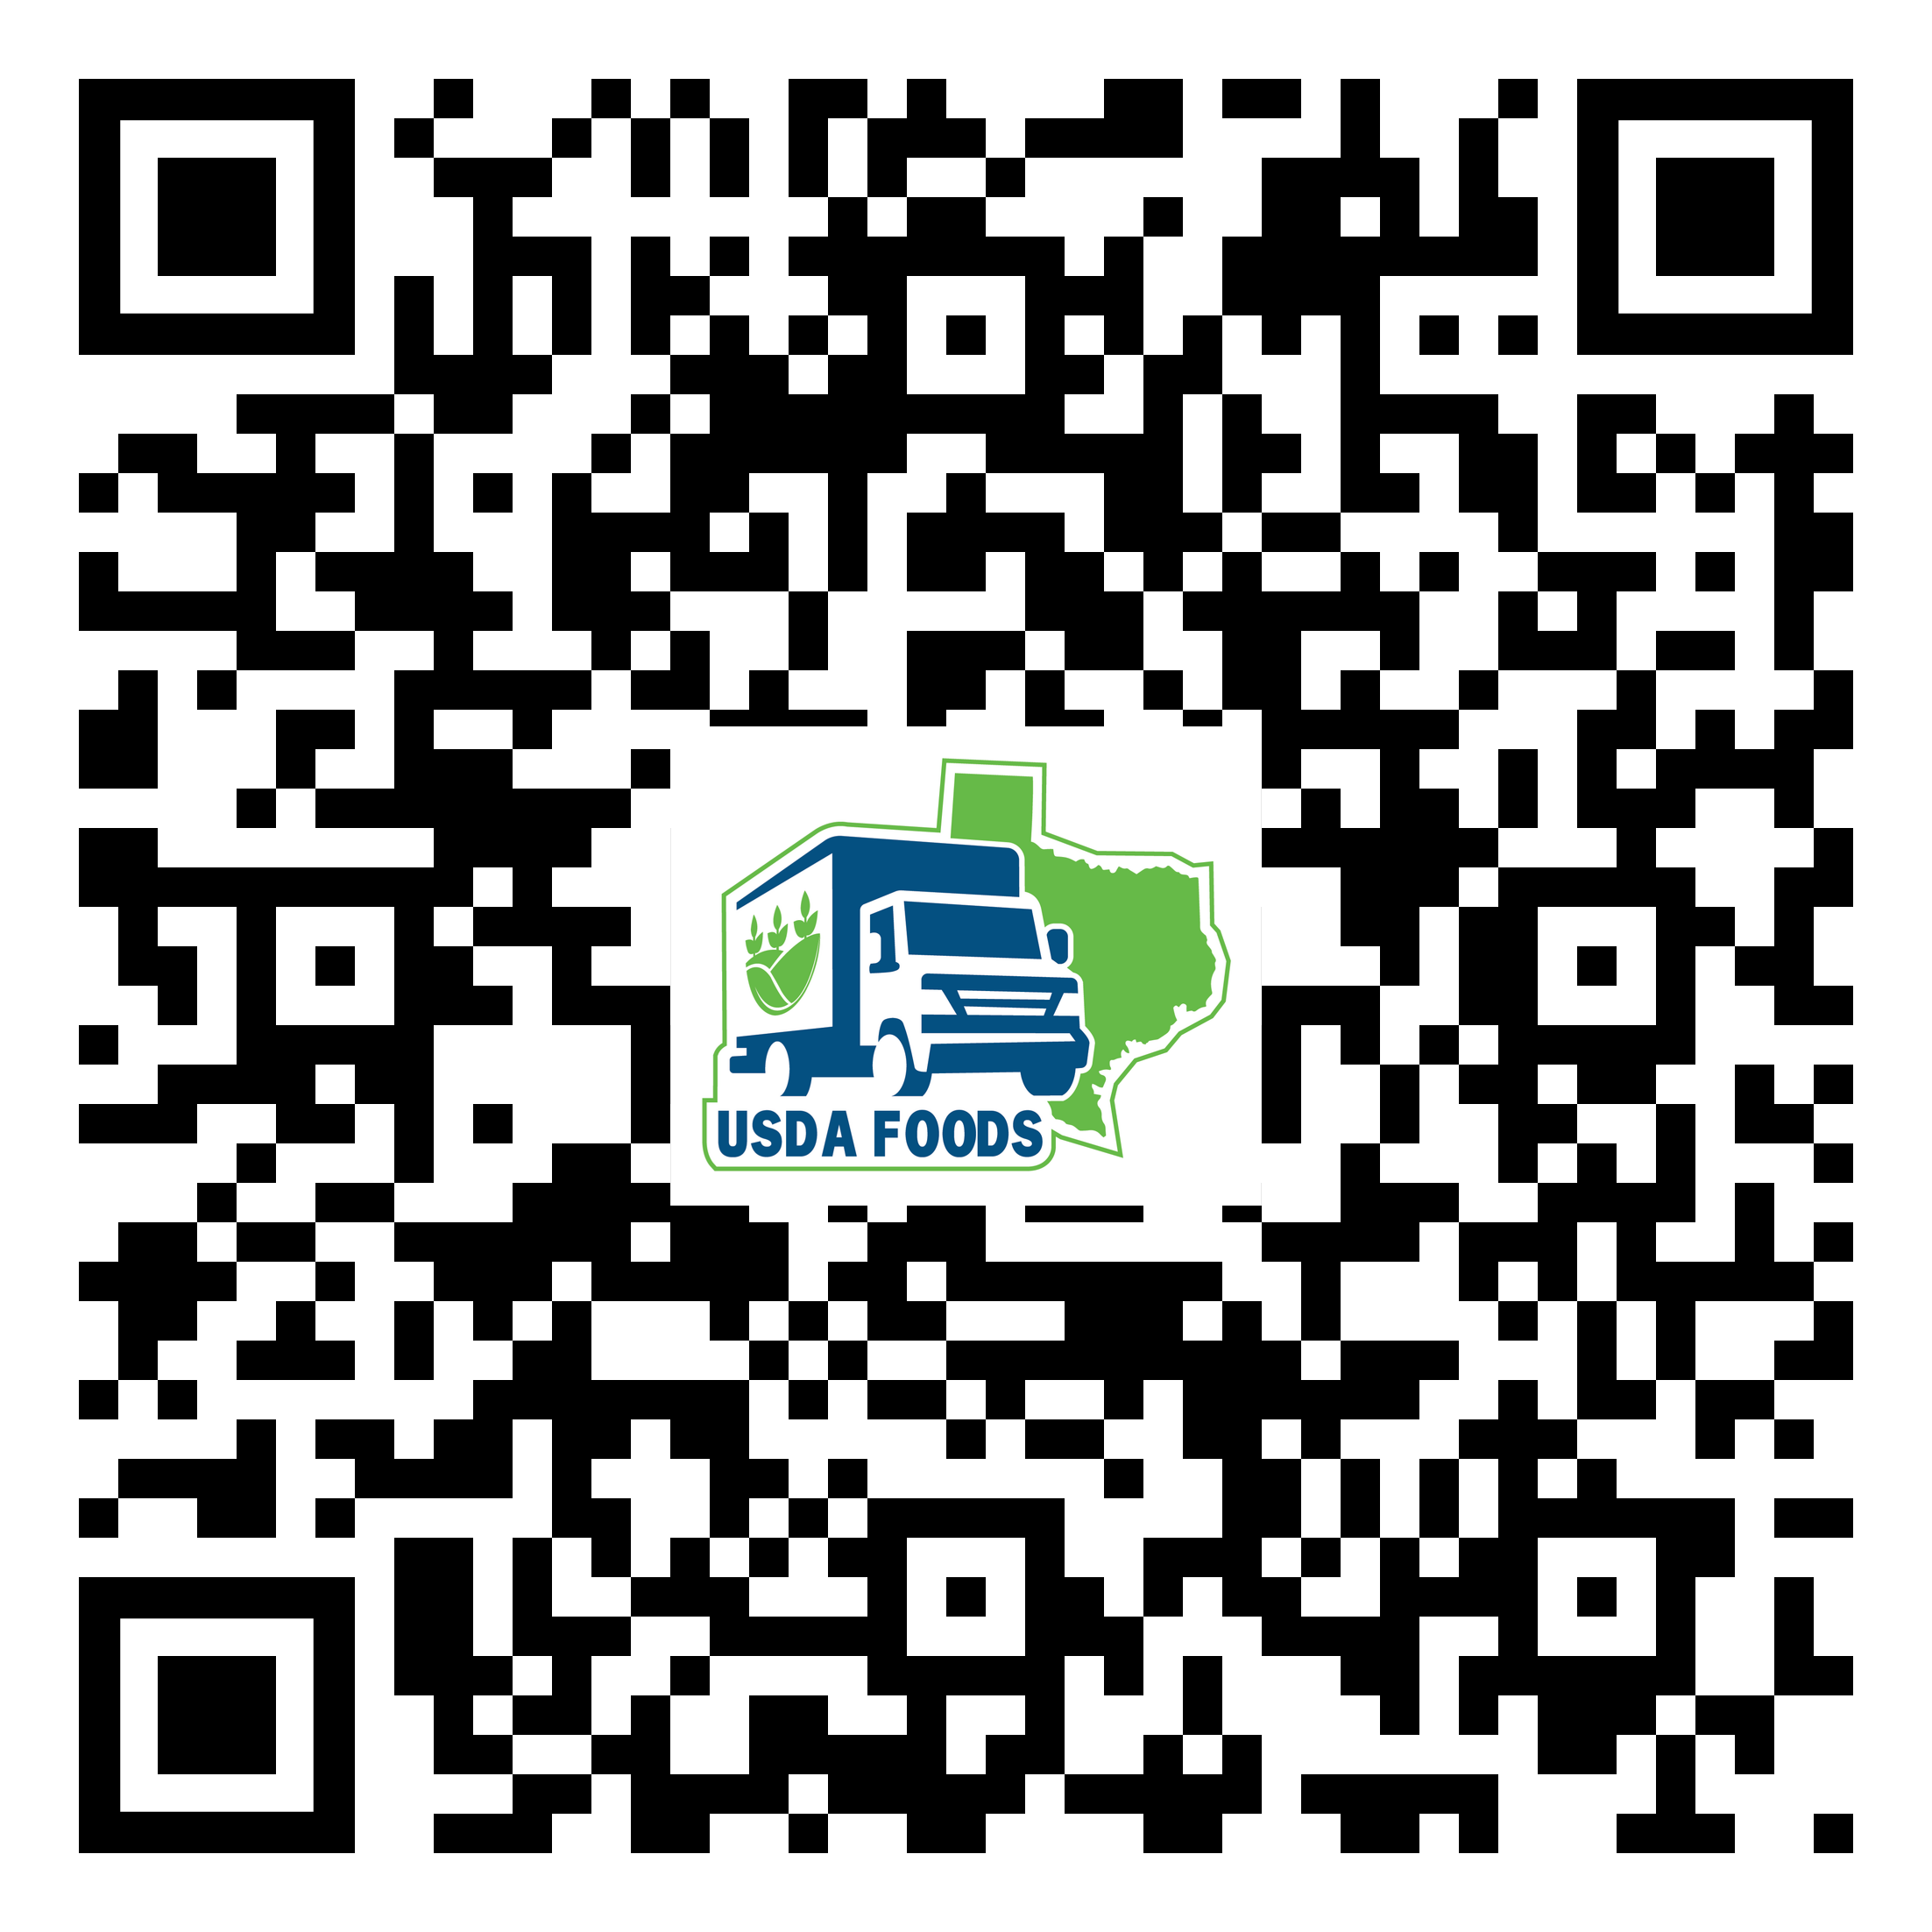
WBSCM Transition Page QR Code:
Scan QR Code to visit the Food Distribution Program WBSCM Transition website

Slide 44
Lab Time:
Notes:
Allow for lab time if needed to let users update security settings.

Slide 46
Contact Us
https://squaremeals.org/Programs/FDPWBSCMTransitionProject.aspx
Contact Your Education Service Center

